Slide 1
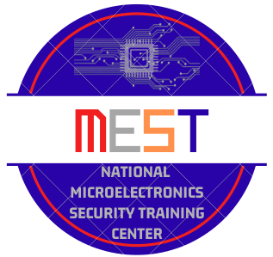


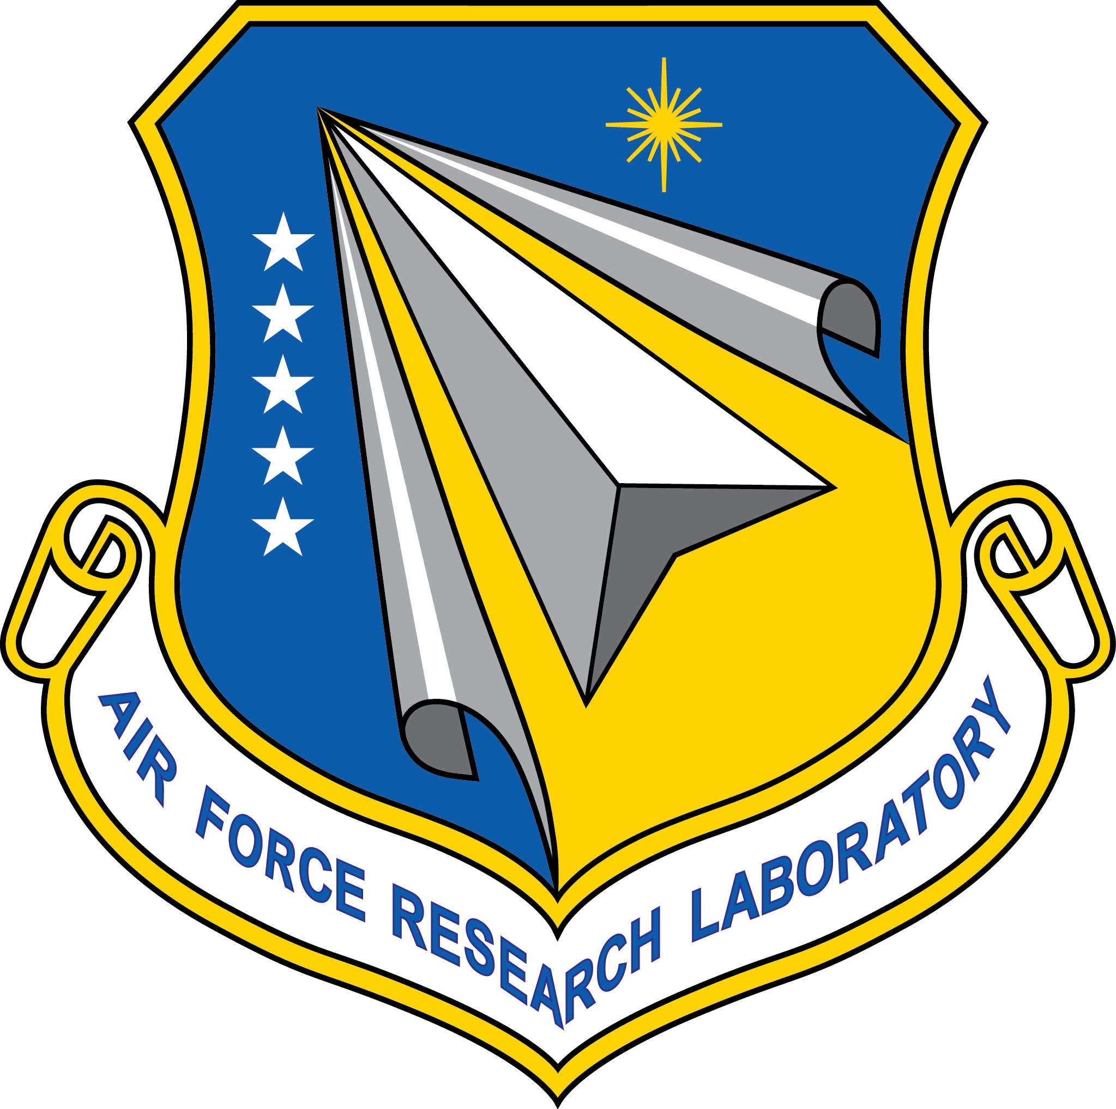

Welcome to the Webinar Offered by: National Microelectronics Security Training (MEST) Center
Sponsors:
Notes:
Welcome to the Microelectronics…webinar titled this this
Until 12:03 or send to instructor to have them keep slide for the first 5-8 minutes MEST Logo title and logo name
Uf logo and OSU logo, sponsors AFRL and Nimbis.

Slide 2

Introduction to PetaLinux Embedded Operating Systems
Abigail Butka, Kawser Ahmed Muhammed, Wade Fortney, Christophe Bobda
National Micro Electronics Security Training (MEST) Center

Slide 3
Agenda
System-on-Chip Refresher
Operating Systems
Definition
Uses
Benefits
Application to Systems-on-Chip
Basic Lab Architecture
Conclusion and Discussion
National Micro Electronics Security Training (MEST) Center

Slide 4
SoC- Architecture
Software
Tasks
Program
memory
Processor
Peripheral
SW Interface
Bus
HA Interface
…
IP1
IP3
Peripheral
IP2
National Micro Electronics Security Training (MEST) Center

Slide 5
Operating Systems

Slide 6
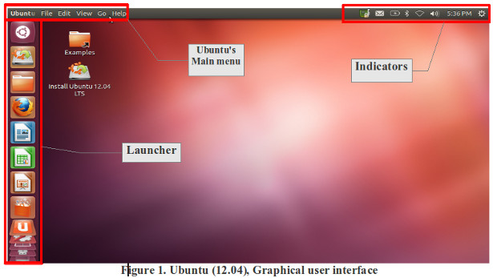
What is an Operating System?
When you think of an operating system, what do you think of?
National Micro Electronics Security Training (MEST) Center

Slide 7
What is an Operating System?
An operating system is a layer of software that acts as an intermediary between the computer hardware and software applications
Operating systems allow users to utilize hardware, like your computer’s CPU, without requiring knowledge of how the hardware works
Two main views to characterize operating systems
Service Provider
Resource Manager
National Micro Electronics Security Training (MEST) Center

Slide 8
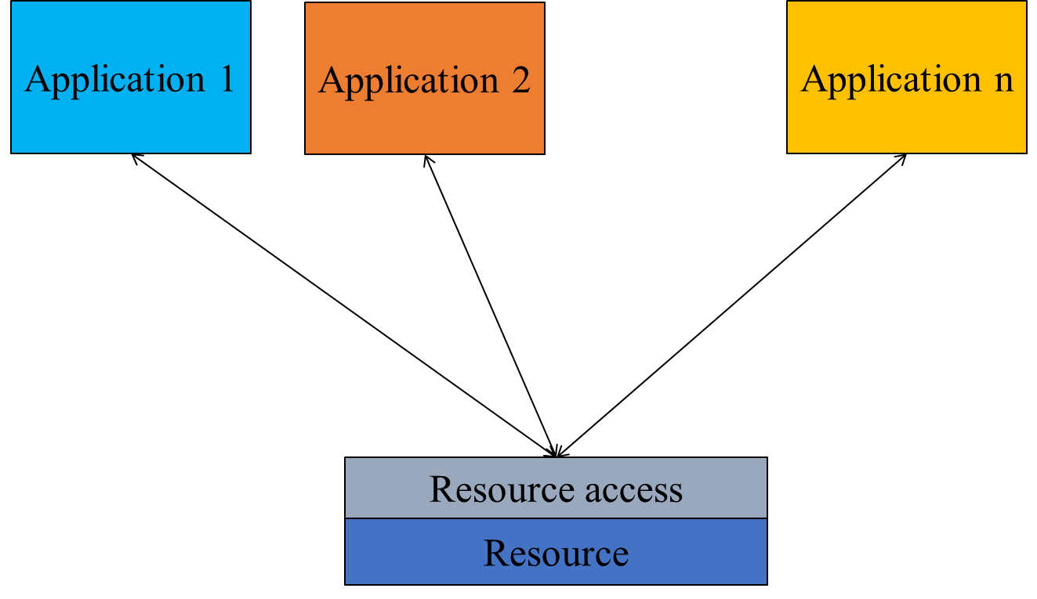
Operating System as a Service Provider
As a service provider, the operating system hides the low-level details from the user to provide a simplified experience
Task
Application Programming Interfaces (APIs) to allow applications to request resources
User Interface or Graphical User Interface
File-system management
Advantage
Performance
Modularity
Memory usage
Time to market
Reliability
Maintainability
Portability
Scalability
National Micro Electronics Security Training (MEST) Center

Slide 9
Operating System as a Resource Manager
As a resource manager, the operating system ensures that each program gets its required time with and space on their required resources
Task
Provide the environment under which program can run
Control and manage the access to resources by concurrent programs
Processor management
Memory management
Provide protection and security
Application 1
Application 2
Application n
Resource Management
Resources (Hardware)
National Micro Electronics Security Training (MEST) Center

Slide 10
Operating System Concepts
The operating system is a layer of software that acts as an intermediary between the computer hardware and software applications. It provides:
Process management
Processes need resources to accomplish their task
Upon completion, resources must be re-allocated
Can be single-threaded (sequential instructions) or multi-threaded (multiple instructions running at once)
Memory management
Ensure all data/instructions are in memory before process execution
Determine what is where inside of the memory and when
Allocating and deallocating memory
Operating system is responsible for:
Creating and deleting user and system processes
Suspending and resuming processes
Providing mechanisms for process synchronization, communication, and deadlock handling
File-system management
Etc...
National Micro Electronics Security Training (MEST) Center

Slide 11
Operating System Concepts
Additionally, the operating system must provide protection and security
Protection – any mechanism for controlling access of processes or users to resources defined by the OS
Security – defense of the system against internal and external attacks
Systems generally first distinguish among users to determine who can do what
User identities (user IDs, security IDs) include name and associated number, one per user
User ID then associated with all files and processes of that user to determine access control
National Micro Electronics Security Training (MEST) Center

Slide 12
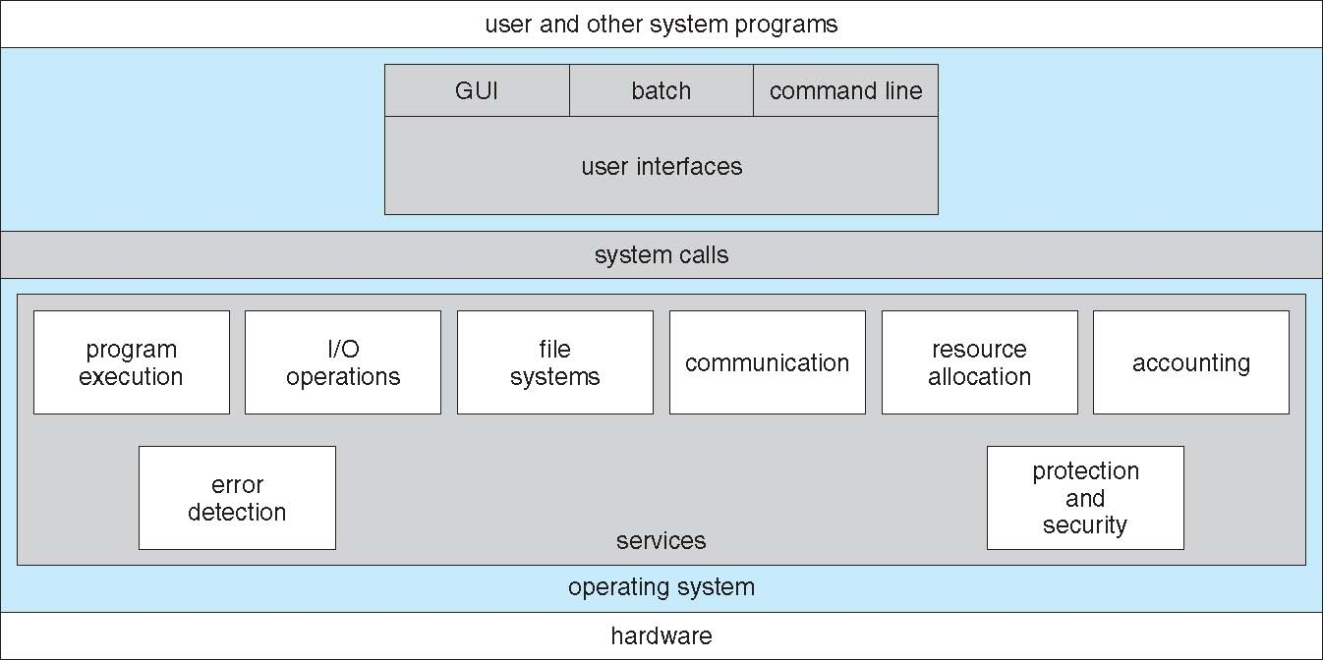
Why Should we use Operating Systems?
Operating systems provide many useful functions such as:
User interface, Graphics User Interface (GUI), and Command Line Interface
Program execution
I/O operations
File-system manipulation
Error detection
Hardware resource management, mapping, and allocation
National Micro Electronics Security Training (MEST) Center

Slide 13
How do we use Operating Systems in SoCs?
PetaLinux
PetaLinux is a set of tools that can create a specialized, embedded Linux environment for Xilinx FPGAs
This Linux environment, or operating system, is commonly referred to as PetaLinux
The PetaLinux tools provide a workflow for creating, building, and deploying Linux
This operating system is unique because it is designed to work with FPGAs and the Vivado workflow
PetaLinux can import System-on-Chip .xsa designs
This allows the user to access and modulate GPIO pins or custom hardware from the operating system
Provides a high abstraction method of accessing low-level components
PetaLinux creates an operating system similar to other Linux-based operating systems, only it can interface directly with Xilinx’s hardware
National Micro Electronics Security Training (MEST) Center

Slide 14
Case Study and Tutorial

